Slide 1
COMP9517 Tutorial 3
Ruiyi Yang
Irfan Dwiki Bhaswara

Slide 2
Reminder
Lab 2 is due on this Friday, 6pm
Lab 3 is out, due next Friday (17 Oct), 6 pm

Slide 3
Agenda
Lab 3 Specification
Image Classification Task
K-Nearest Neighbour
Decision Tree
Stochastic Gradient Descent
Demo

Slide 4
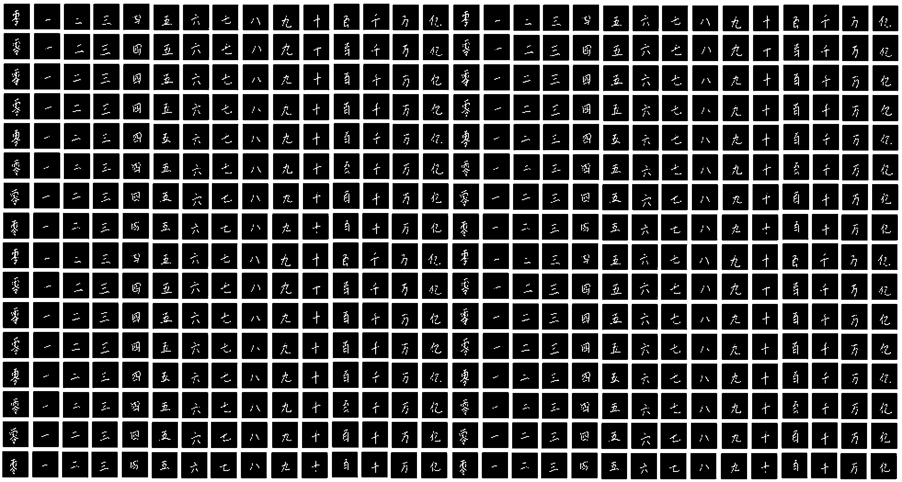
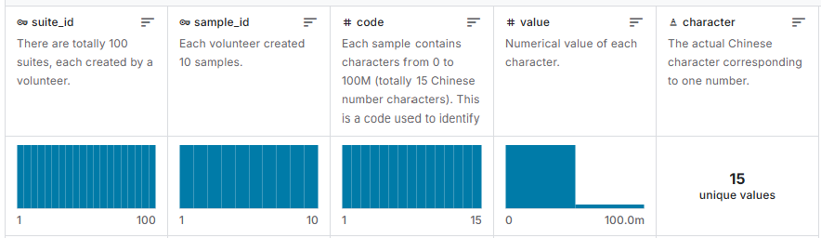
Lab 3 Specification
Objective: familiarise with implementing several algorithms for image classification
Dataset: Chinese MNIST dataset. It consists of images of 15 numbers, handwritten 10 times by 100 volunteers, resulting in 15,000 images. Each image is 64x64 pixels.
Notes: Your results will have an accuracy of around 20-40%.
Ensure that you use proper class labels. Don’t forget to stratify when splitting the dataset & report performance for each classifier. You don’t need to give an explanation for this lab
https://www.kaggle.com/datasets/gpreda/chinese-mnist

Slide 5
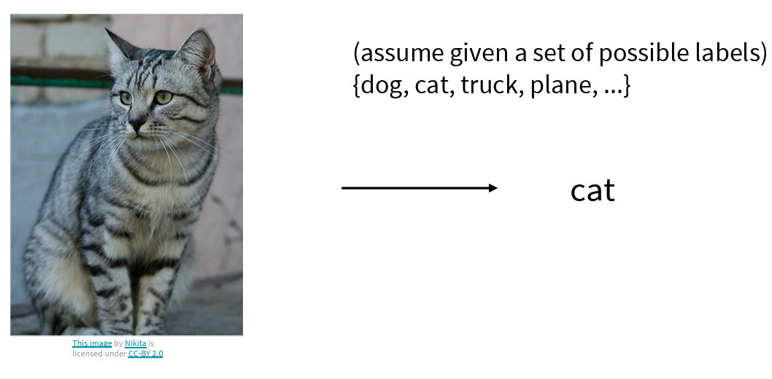
Image Classification
Categorising images into pre-defined classes or categories
Slides from Fei-Fei Li, Ehsan Adeli https://cs231n.stanford.edu/slides/2024/lecture_2.pdf

Slide 6
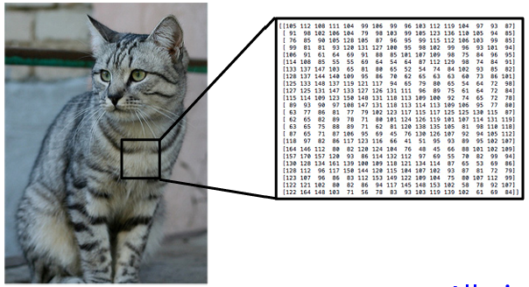
Image Classification
An image is a tensor of integers between [0, 255]
Image classifier -> calculate probability of image belonging each label based on feature space (Pick label with highest probability)
Slides from Fei-Fei Li, Ehsan Adeli https://cs231n.stanford.edu/slides/2024/lecture_2.pdf

Slide 7
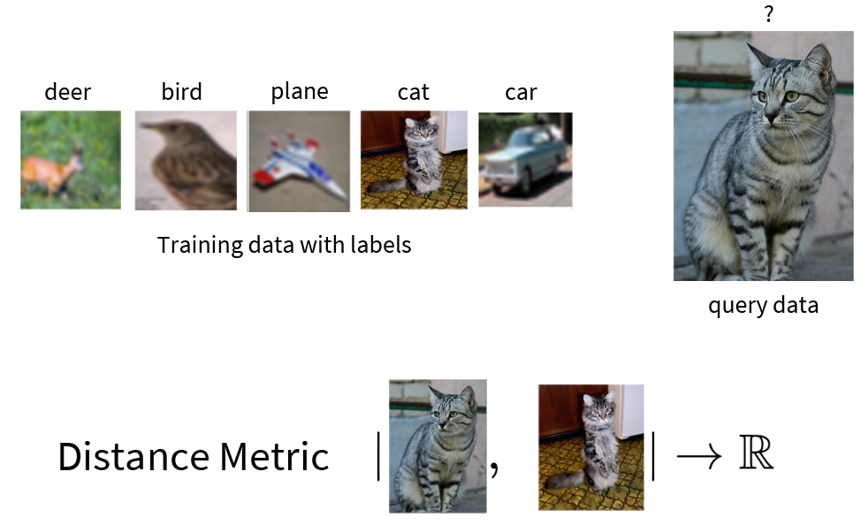
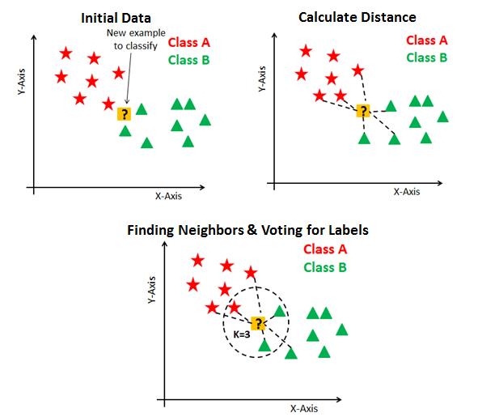
K-Nearest Neighbour
Methods:
Read dataset
Map training to feature space
For each testing image, find K images, that are “closest” to it (e.g. Euclidean Distance)
Predict majority class among K images
Cons: Doesn’t work well when feature space is large. High time complexity
Slides from Fei-Fei Li, Ehsan Adeli https://cs231n.stanford.edu/slides/2024/lecture_2.pdf

Slide 8
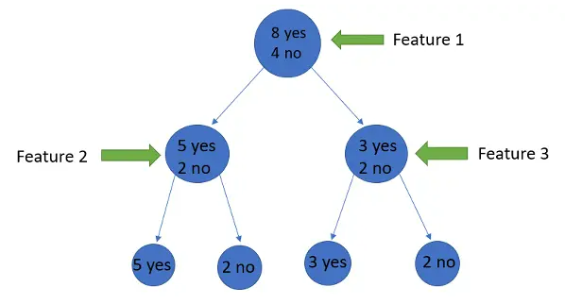
Decision Trees
Methods:
Each node represent a feature, and each leaf is a label
Each node has several branches and partitioned into different branches of tree
Feature to split: largest information gain
Cons: Tends to overfit
https://www.analyticsvidhya.com/blog/2021/08/decision-tree-algorithm/

Slide 9
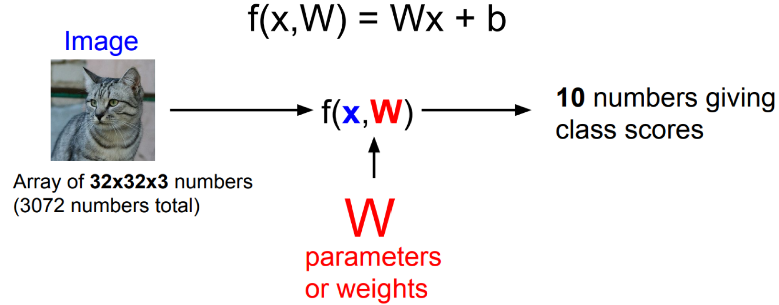
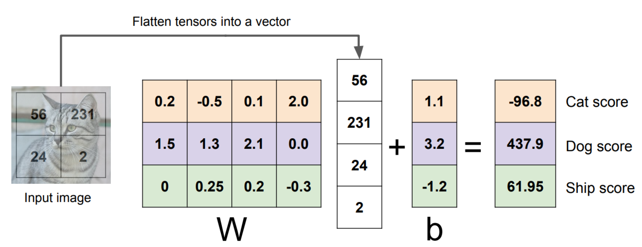
Stochastic Gradient Descent
Stochastic Gradient Descent (SGD) is an optimisation algorithm that iteratively updates model parameters to minimise an objective function
SGD helps to find the ‘best’ parameter weight W that separates classes
Slides from Fei-Fei Li, Ehsan Adeli https://cs231n.stanford.edu/slides/2024/lecture_2.pdf

Slide 10

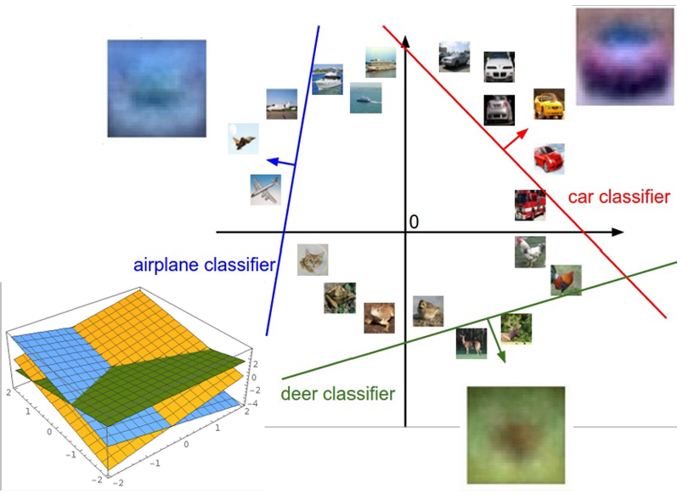
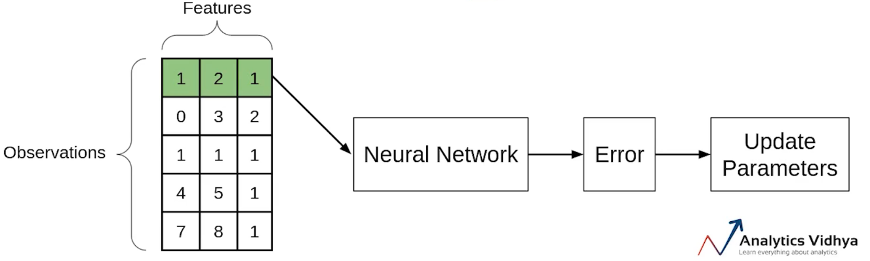
Stochastic Gradient Descent
SGD pass a single observation at a time, calculate the cost and update the parameters.
Slides from Fei-Fei Li, Ehsan Adeli https://cs231n.stanford.edu/slides/2024/lecture_2.pdf
https://www.analyticsvidhya.com/blog/2021/03/variants-of-gradient-descent-algorithm/

Slide 11
Demo

